Slide 1
Quora Insincere Questions Classification
Group 17 - Hardly Humans
Name | Enrollment Number
Sanya Zaveri | AU1920064
Mihir Pathak | AU1920138
Parth Shah | AU1940065
Malav Doshi | AU1940017

Slide 2
Introduction
Quora is a website where a community of users can ask and answer questions.
Some of the characteristics that can signify that question might be insincere are:
Consists of a non-neutral tone
Question is disparaging or inflammatory.
Question is not grounded in reality
Notes:
Quora has 300 million monthly active users
Insincere questions - Insinuate a feeling in the readers

Slide 3
Sincere Questions | Insincere Questions
How did Quebec nationalists see their province as a nation in the 1960s? | Has the United States become the largest dictatorship in the world?
Do you have an adopted dog, how would you encourage people to adopt and not shop? | Which babies are more sweeter to their parents? Dark skin babies or light skin babies?
Why does velocity affect time? Does velocity affect space geometry? | If both Honey Singh and Justin Bieber fall from the 5th floor, who will survive?
How did Otto von Guericke used the Magdeburg hemispheres? | Why don't poor countries print more money to use for paying for education, etc.?
Can I convert montra helicon D to a mountain bike by just changing the tyres? | Why did Pakistan pass the Sikh Marriage Act before India?

Slide 4
Problem statement
As being in top 10 most visited social networks in the world, censoring the content of questions is also an extremely important factor to make the value of this social network.
This problem focus on determining whether a question asked on Quora is insincere or not. The input is a text string and the output is 0 (sincere) or 1 (insincere).
It is a binary classification problem.
Notes:
Quora is an online forum where users post questions and other users answer those

Slide 5
Related Work
Text Classification on various parameters.
IEEE model for classifying tweets.
Various models like logistic regression applied.
Various models for classification.
Naive-bayes, logistic regression, random forest and SVM could be used.
[1] S. T. Indra, L. Wikarsa and R. Turang, "Using logistic regression method to classify tweets into the selected topics,"
Notes:
Health, Sports, Technology and Music were typical tweets by netizens. Previous IEEE research where logistic regression is used.Text-feature extraction. Similar steps such as preprocessing, removing stop words, stemming (from where we came across lemmatization), tokenization.4 models Naive-bayes, logistic regression, random forest and SVM (Support Vector machine).

Slide 6
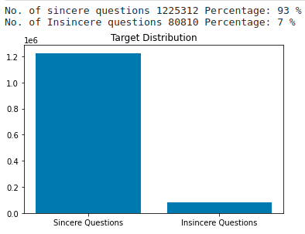
Data analysis²
The dataset is from Kaggle competition of Quora Insincere Questions Classification².
Bar-graph to visualize.
Total entries are 1.3 million
93% were sincere and 7% insincere questions.
Figure 1
[1] https://www.kaggle.com/c/quora-insincere-questions-classification/data
[2] Nima, Prateek. (2019). Quora Insincere Questions Classification.

Slide 7
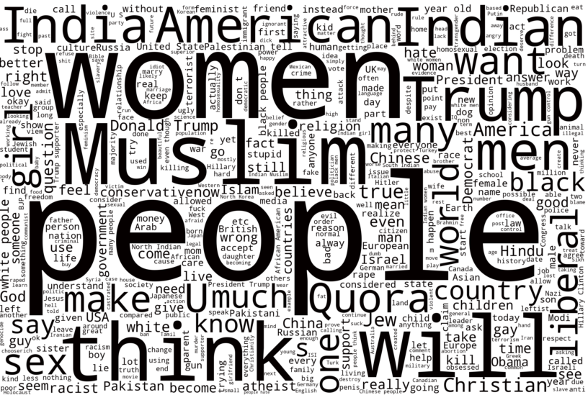

Visualization via WordCloud¹.
Words with similar roots observed, lemmatization is required.
Stop words such as “will” observed, hence removing stop words required.
Insincere Questions WordCloud
Sincere Questions WordCLoud
[1] Nima, Prateek. (2019). Quora Insincere Questions Classification.

Slide 8
Data preprocessing¹
Stopwords
Focus on value adding words.
Used nlkt library.
Lemmatization
Clustering similar words - {dance}: {dancing, to dance}
used WordNetLemmatizer
Notes:
Stopwords do not add much meaning - connectors
They should be removed to shift focus
Nltk library
Lemmatization

Slide 9
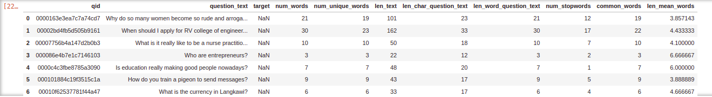
Feature engineering
Adding 8 features to the raw data using domain knowledge.
Notes:
Potential question - How to decide which feature to include in the model?

Slide 10
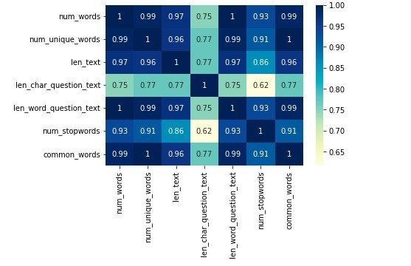
Correlation matrix
We observe that these features do not add much value from the correlation matrix.

Slide 11
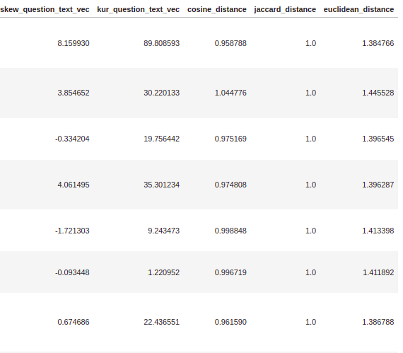
TF-IDF & Word2Vec
Here we are adding 5 additional features using term frequency, inverse document frequency and word2vec.

Slide 12
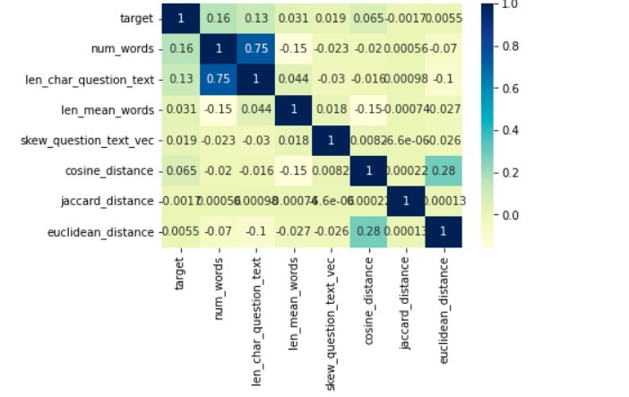
Correlation matrix (after adding TF-IDF & Word2Vec)
Relevance of Features.
Removing redundant features.
Independence and uniqueness of a feature.
Contribution for model training.

Slide 13
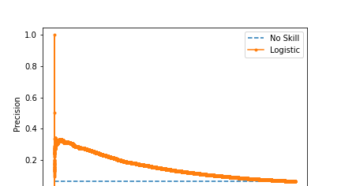

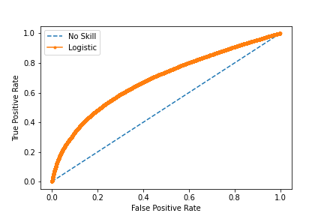
Modeling & Results
PR curve:
Logistic Regression:
Imported logistic regression from sklearn.linear_model.
Parameters: C=0.1, solver='sag'
ROC curve:
Notes:
Precision is correctly predicted upon total predicted outcomes - Recall is correctly predicted upon total outcomes
Potential Question - What is C/Solver/Max_iteration and its consequence?

Slide 14
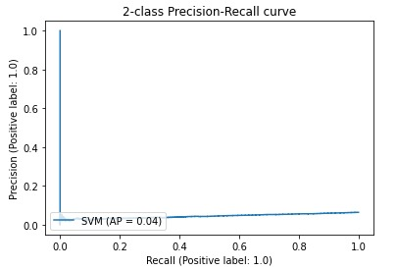

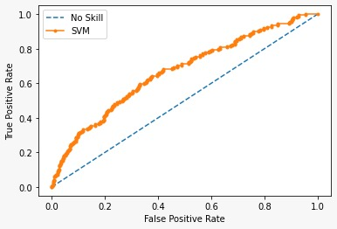
PR Curve:
2. SVM (for small dataset -13000 data points)
Imported SVC from sklearn.svm
Parameters: C=0.2,kernel='linear',gamma=1
ROC Curve

Slide 15
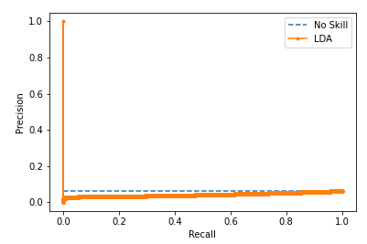

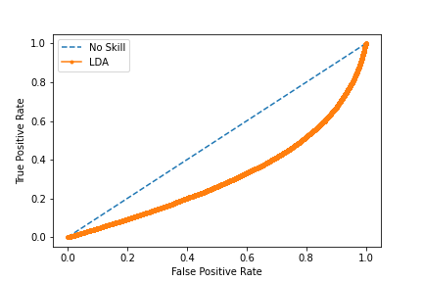
PR Curve:
3. LDA
Imported Linear Discriminant Analysis model from sklearn.LinearDiscriminantAnalysis
ROC curve:
Notes:
Precision is correctly predicted upon total predicted outcomes - Recall is correctly predicted upon total outcomes
Potential Question - What is C/Solver/Max_iteration and its consequence?

Slide 16
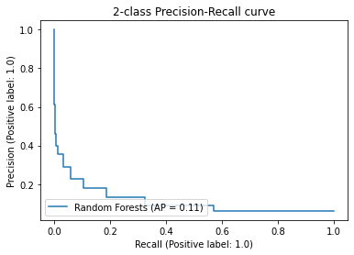

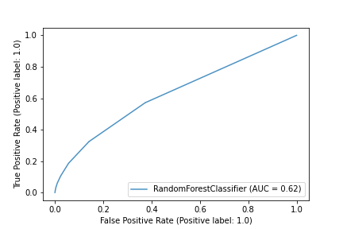
PR Curve:
4.. Random Forest
Imported RandomForestClassifier from sklearn.ensemble
ROC Curve:
Notes:
Precision is correctly predicted upon total predicted outcomes - Recall is correctly predicted upon total outcomes
Potential Question - What is C/Solver/Max_iteration and its consequence?

Slide 17
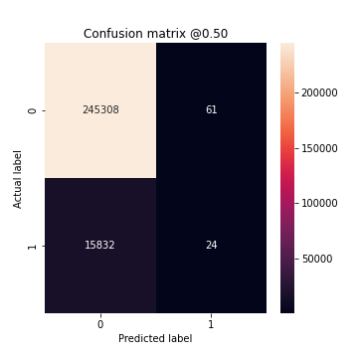
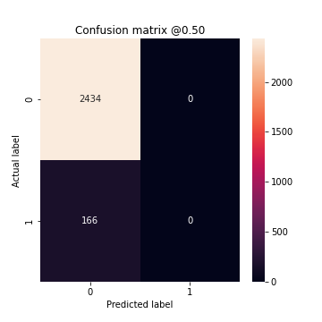
Confusion matrix
Logistic Regression
2. SVM

Slide 18


Confusion matrix
3. LDA
4. Random forest

Slide 19
Data Balancing
Methods to Balance the dataset.
Discarding the majority
Oversampling
SMOTE(Synthetic Minority Oversampling Technique)
Ensemble

Slide 20
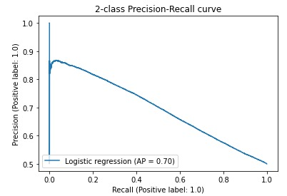
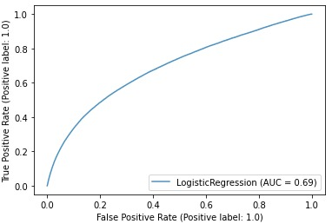
After Balancing
PR Curve:
ROC Curve
PR Curve

Slide 21
Inference - Skewed Data
Model | Training Accuracy | Testing Accuracy | F1 score | Precision | Recall
Logistic Regression | 0.937 | 0.939 | 0.910 | 0.899 | 0.939
SVM | 0.938 | 0.936 | 0.905 | 0.940 | 0.936
LDA | 0.934 | 1.000 | 0.912 | 0.901 | 0.936
Random Forest | 0.988 | 0.938 | 0.912 | 0.905 | 0.938
Random forest is the best model as it has the highest f1-score, precision and recall.

Slide 22
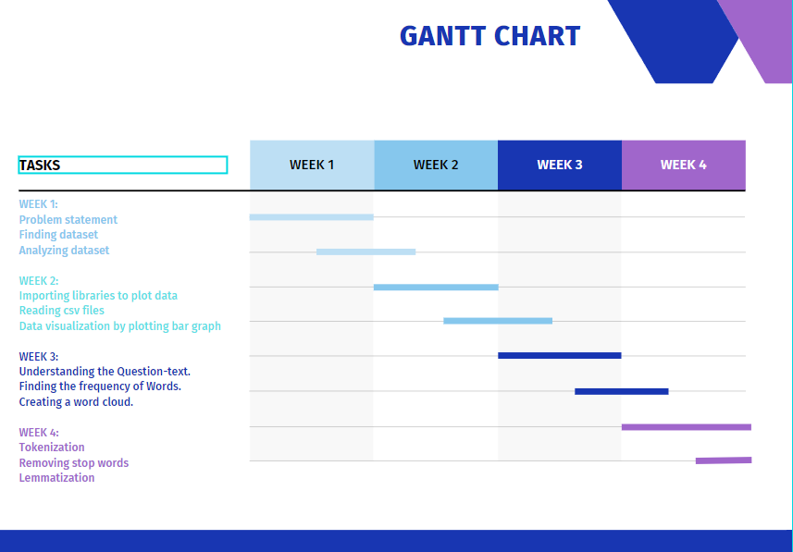
Project Timeline

Slide 23
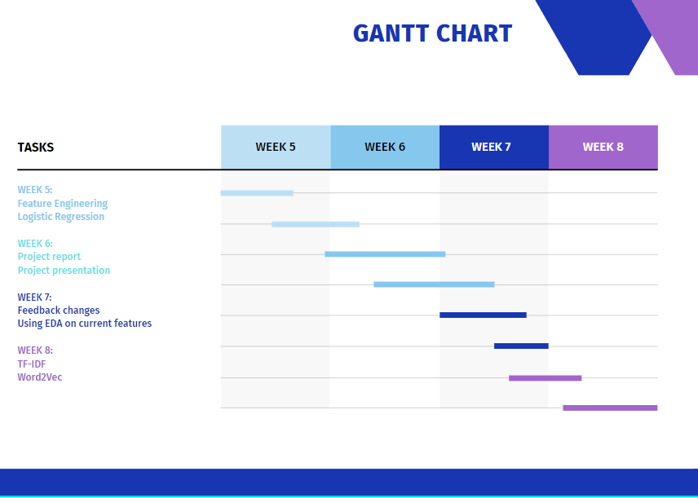

Slide 24
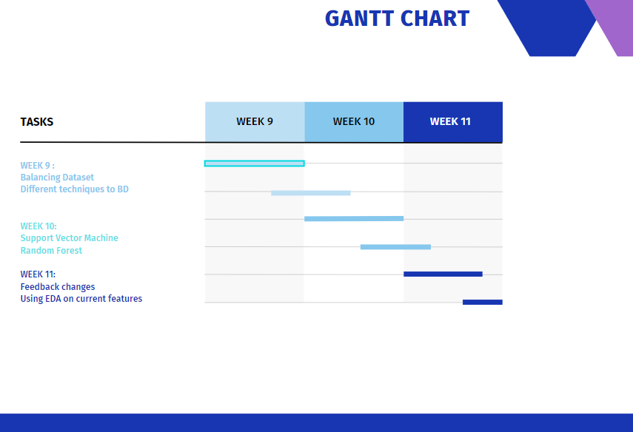

Slide 25
Role of each group member
Data Analysis - Sanya, Mihir, Malav, Parth
Data Preprocessing - Sanya, Mihir, Malav, Parth
Feature Engineering - Sanya, Mihir, Malav, Parth
Modeling - Sanya, Mihir, Malav, Parth
Inferences - Sanya, Mihir, Malav, Parth

Slide 26
References
S. T. Indra, L. Wikarsa and R. Turang, "Using logistic regression method to classify tweets into the selected topics," 2016 International Conference on Advanced Computer Science and Information Systems (ICACSIS), 2016, pp. 385-390, doi: 10.1109/ICACSIS.2016.7872727.
O. Aborisade and M. Anwar, "Classification for Authorship of Tweets by Comparing Logistic Regression and Naive Bayes Classifiers," 2018 IEEE International Conference on Information Reuse and Integration (IRI), 2018, pp. 269-276, doi: 10.1109/IRI.2018.00049.
“Sklearn.linear_model.logisticregression,” scikit. [Online]. Available: https://scikit-learn.org/stable/modules/generated/sklearn.linear_model.LogisticRegression.html. [Accessed: 20-Mar-2022].
“Precision-recall,” scikit. [Online]. Available: https://scikit-learn.org/stable/auto_examples/model_selection/plot_precision_recall.html. [Accessed: 20-Mar-2022].
Y. Liu, J. Niu, Q. Zhao, J. Lv and S. Ma, "A Novel Text Classification Method for Emergency Event Detection on Social Media," 2018 IEEE SmartWorld, Ubiquitous Intelligence & Computing, Advanced & Trusted Computing, Scalable Computing & Communications, Cloud & Big Data Computing, Internet of People and Smart City Innovation (SmartWorld/SCALCOM/UIC/ATC/CBDCom/IOP/SCI), 2018, pp. 1106-1111, doi: 10.1109/SmartWorld.2018.00192.

